Slide 1


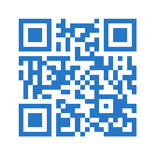

Scotland’s only FREE Data Platform Community Event
14
September
2018
A full day, 24 training sessions across 4 tracks
covering all aspects of the Microsoft Data Platform:
SQL Server | Azure | Power BI | PowerShell | Business Intelligence | Data Warehousing | Data Science | Analytics
More info at: SQLGLA.co.uk
@SQLGLA
Get news first with our mailing
list: http://bit.ly/sqlgla2018
Registration opens 1st June
Notes:
Data training conference.
FREE
Registration opens in 8 days!

